Slide 1
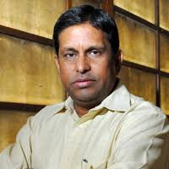
Faculty Development Programme
(December 07-08,2019)
Sponsored by
ITM University Gwalior
for
School of Management
Resource Person:
Prof. N. Ravichandran
(Former Director IIM Indore,
Retired Professor, IIM Ahmedabad)

Slide 2
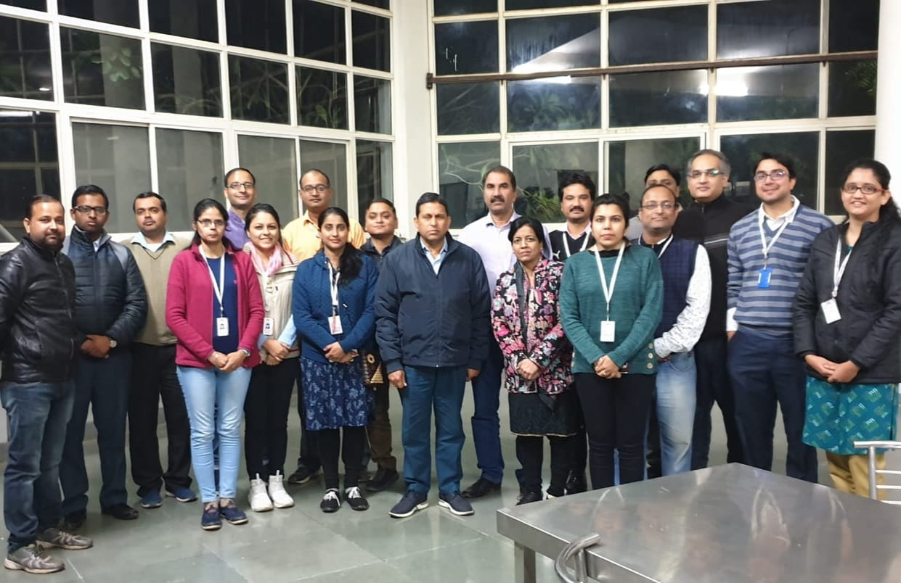
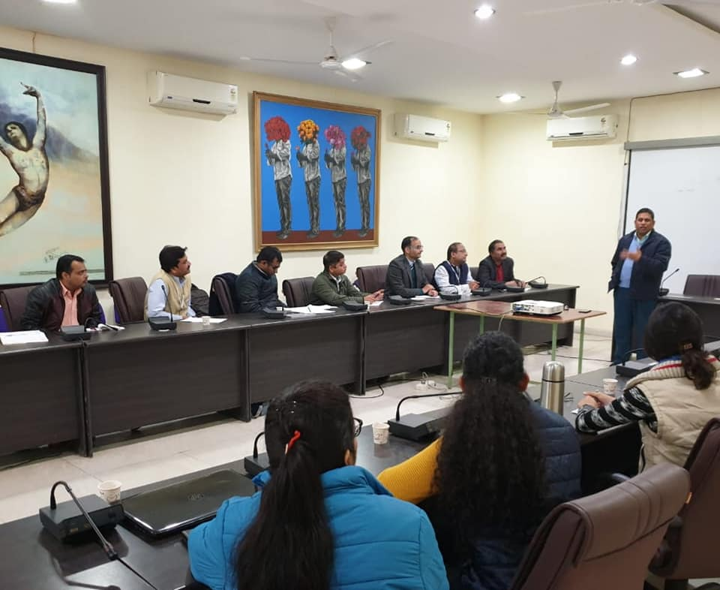
Day One!
A two day Faculty Development workshop was sponsored by ITM University Gwalior for its School of Management (Dec. 07-08, 2019). The eminent resource person for the workshop was Prof. N. Ravichandran (Mentor School of Management, ITM University Gwalior and Former Director, IIM Indore and Retired Professor IIM Ahmedabad).
On the first day, the entire courses and subjects were reviewed to make the courses more value added, relevant and market driven. The serious efforts from the eminent resource person and the SOM faculty members continued till the late evening hours. The sole focus is to equip and improve our SOM students with strategies, concepts, and skills that will help them earn a demanding career in life.
(SOM faculty members posing for a group photograph at dinner time with Eminent Prof. N. Ravichandran)
Picture from FDP Day 01 Session……..

Slide 3
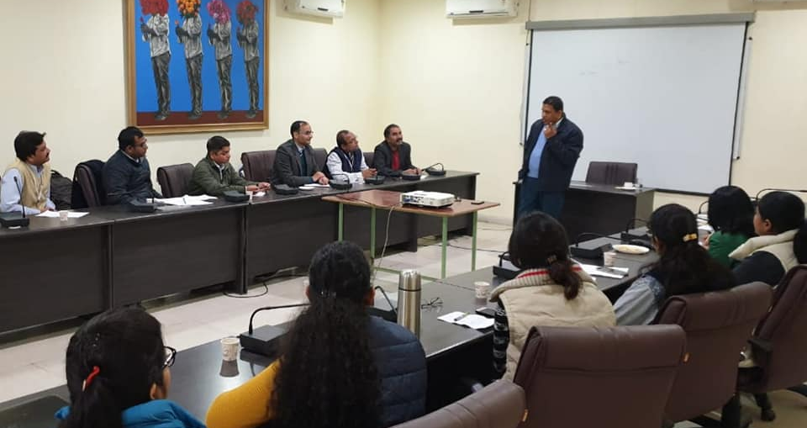
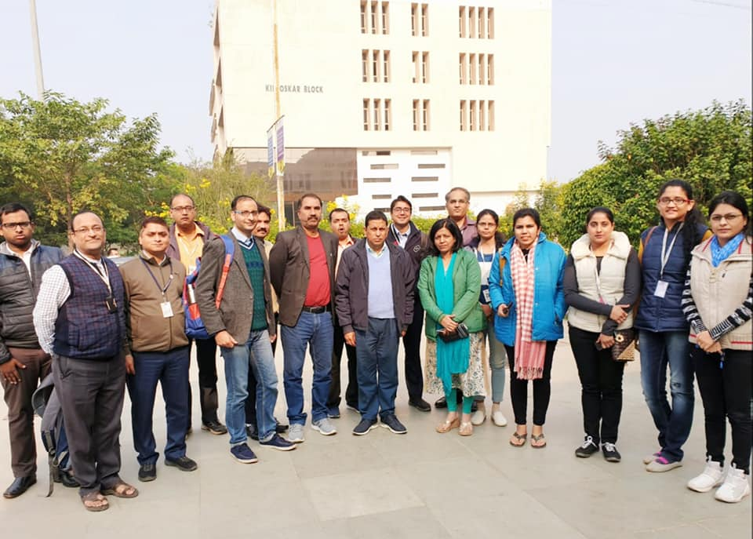
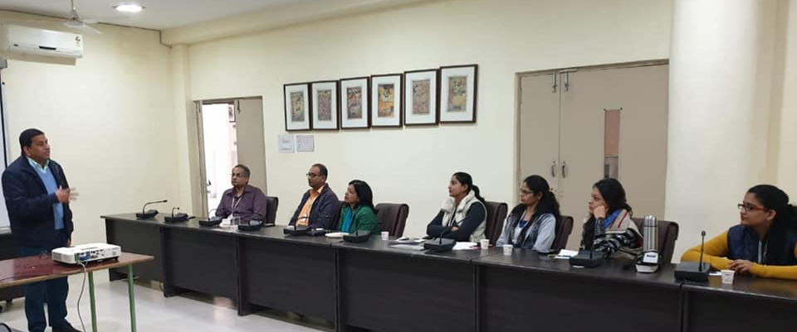
Day Two!
On the second day, the large focus in the sessions was to improve the teaching skills and classroom management and how to get the best results from the students. The two day workshop concluded on a happy note and vote of thanks was delivered by the Dean SOM, Dr. Vandana Bharti and HOD SOM, Prof. Keshav Kansana.
Pictures from FDP Day 02 Sessions……..
(Participants posing for a group photograph after the workshop with Eminent Prof. N. Ravichandran)

Slide 4
Participants:
S. No. | Name | Designation
1 | Dr. Vandana Bharti | Dean, SOM
2 | Prof. Keshav Kansana | HOD, SOM
3 | Dr. Abhinandhan Chakraborthy | Asst. Professor
4 | Dr. Aditya Tripathi | Asst. Professor
5 | Dr. Shahid Amin | Asst. Professor
6 | Dr. Vinay Gupta | Asst. Professor
7 | Dr. Ram Babu Shridhar | Asst. Professor
8 | Dr. Satguru Roshan | Asst. Professor
9 | Mr. Abhishek Singhal | Asst. Professor
10 | Dr. Bhanu Priya | Asst. Professor
11 | Dr. Megha Soni | Asst. Professor
12 | Ms. Simran | Asst. Professor
13 | Ms. Surbhi | Asst. Professor
14 | Dr. Archana Yadav | Asst. Professor
15 | Mr. Amol Mutatkar | Asst. Professor

Slide 5
Thanks
Rapporteur- Dr. Shahid Amin, Asst. Professor, SOM, ITM University Gwalior.

